Slide 1
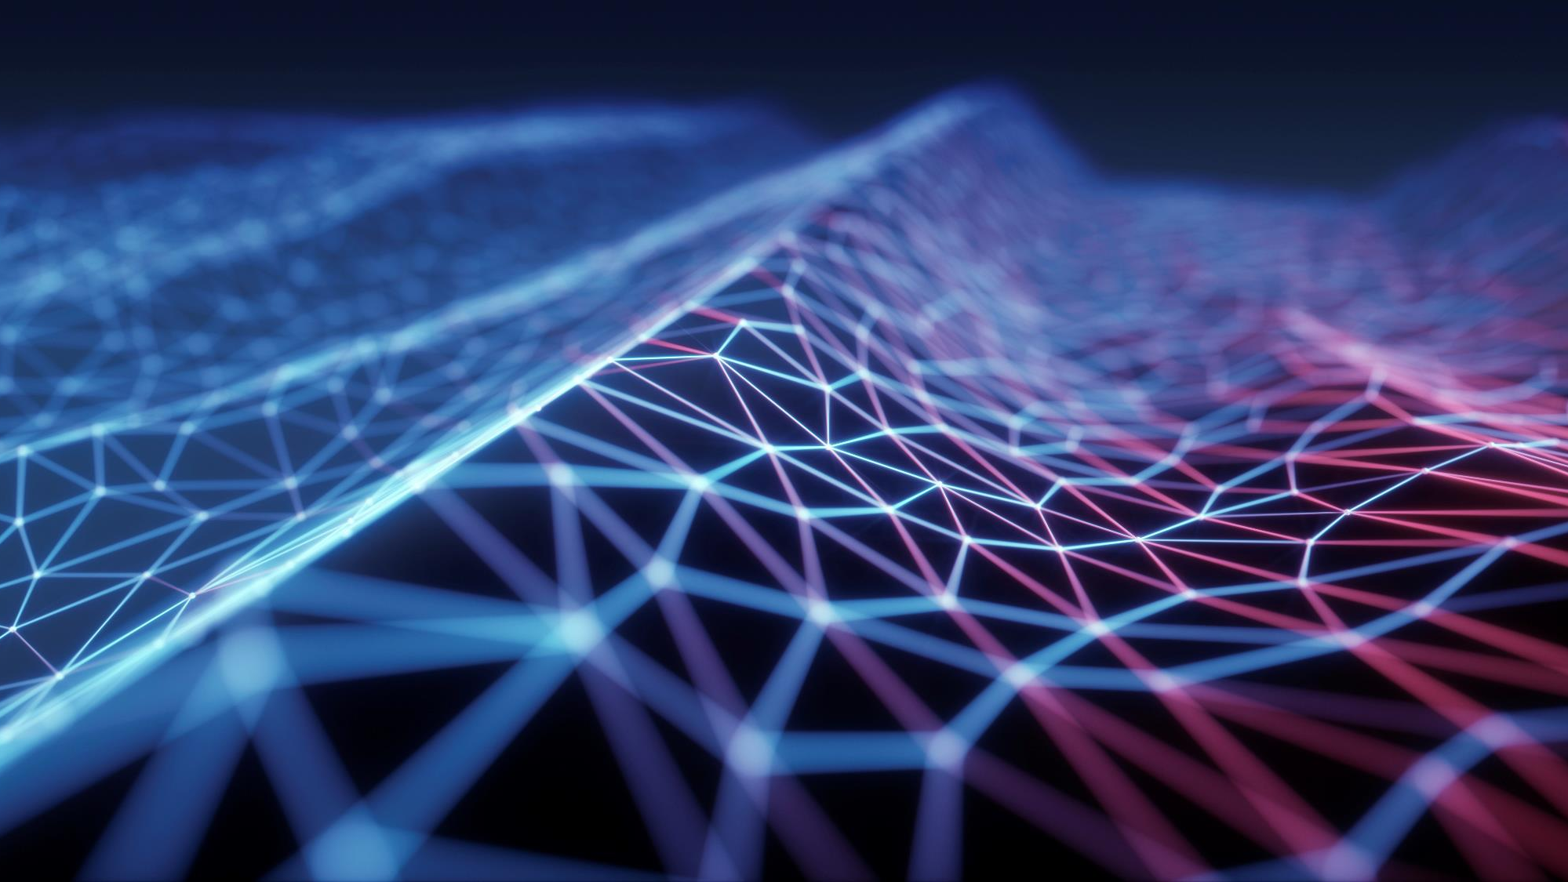
Solar Panels for homes

Slide 2
Why Solar panels from home
Energy costs have been rising every year, our story began on looking for ways to save money in the long run using solar panels for homes.
Another reason why we wanted to research this subject is because it’s an efficient and greener way to use the natural power of the sun to power our household electronics.

